Slide 1
NBA Rookie Predictions
Parker Dixon

Slide 2
NBA Rookie Predictions
Parker Dixon

Slide 3
Drafting the Right Player
What makes a good NBA player?
  Physical Traits
  Mental Makeup
  Skill
Player | Height | Points | Assists | Rebounds | 2P% | 3P% | FT% | SOS | Accolades
NCAA
Player 1 | 6’ 2” | 28.9 | 4.3 | 3.4 | .491 | .396 | .894 | 5.76 | National POY
Player 2 | 6’ 3” | 28.6 | 5.6 | 4.4 | .519 | .387 | .876 | -3.33 | Conference POY

Slide 4
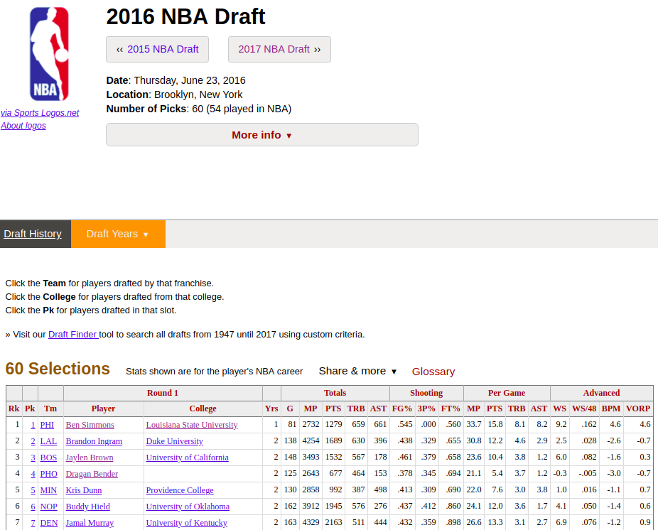
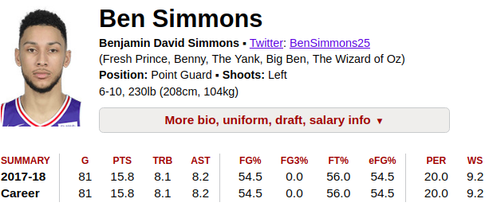
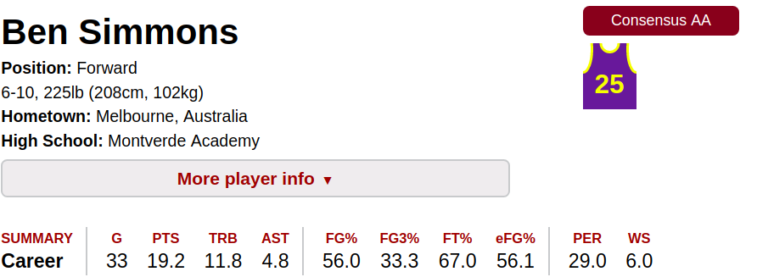
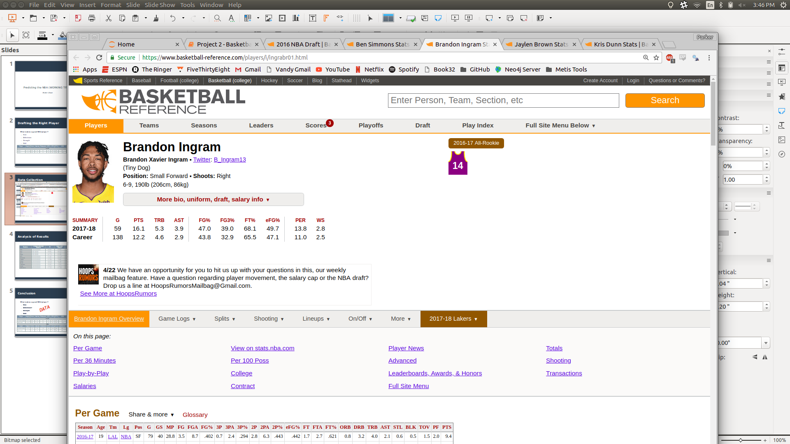
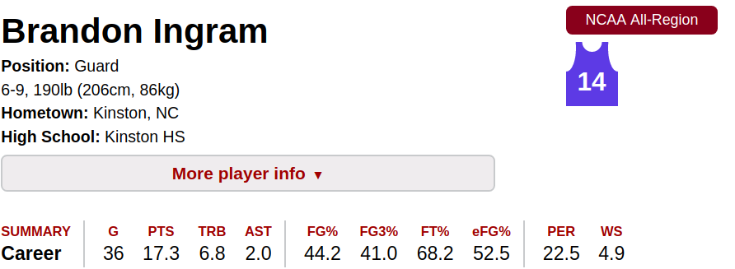
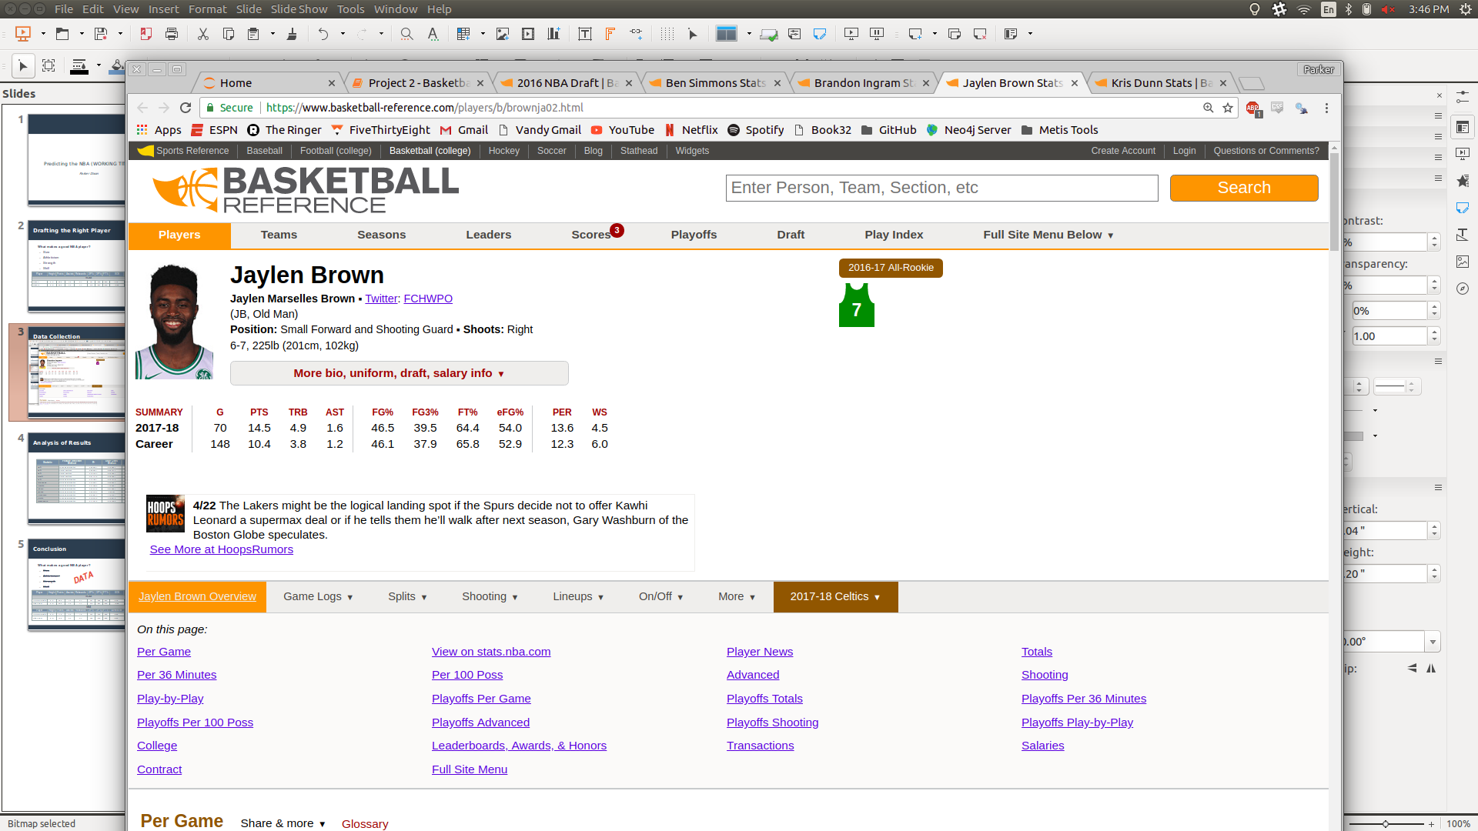
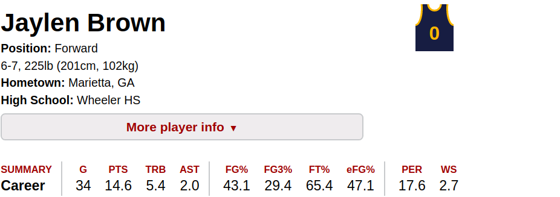
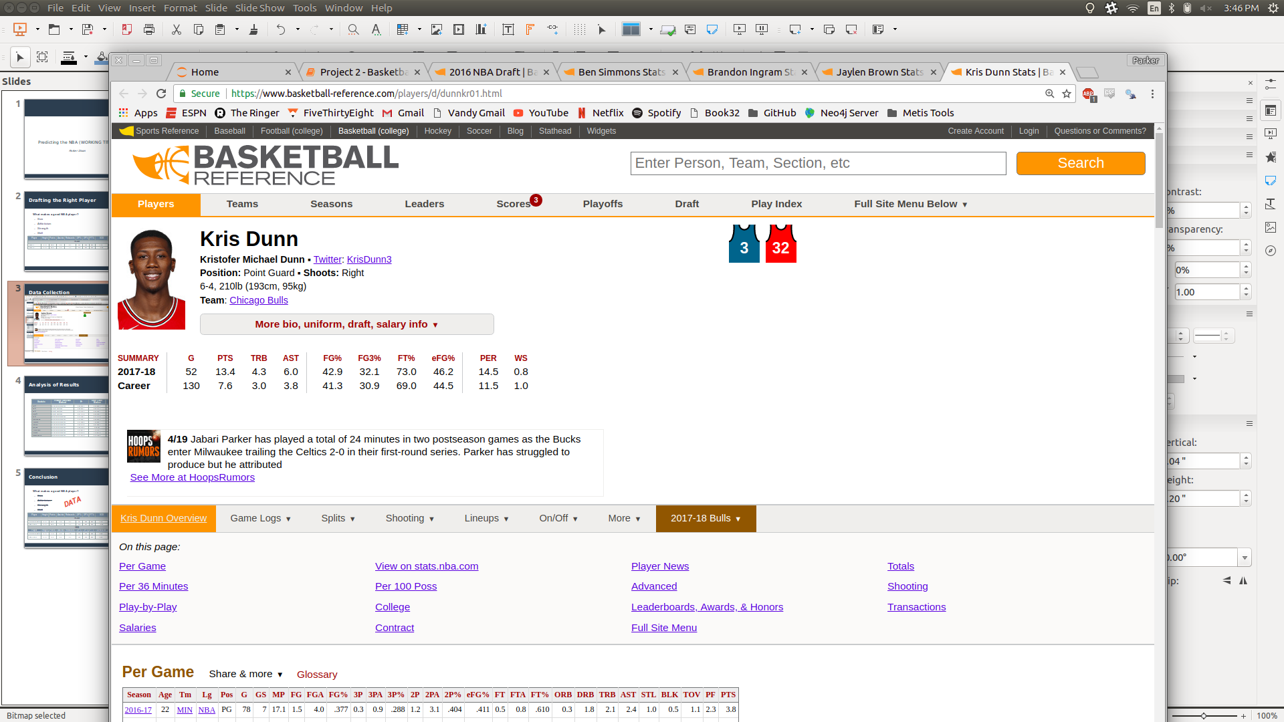

Data Collection

Slide 5
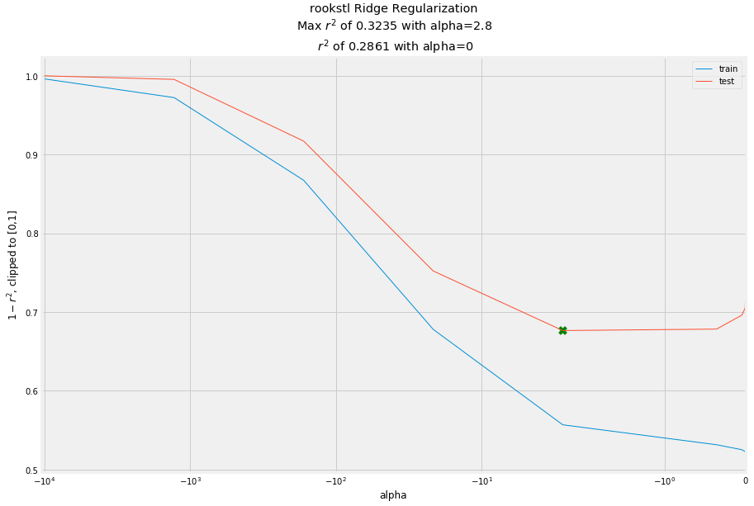
Model Creation
Tested 3 different methods for each model
  K-Best Feature Selection
  Ridge Regularization
  Lasso Regularization

Slide 6
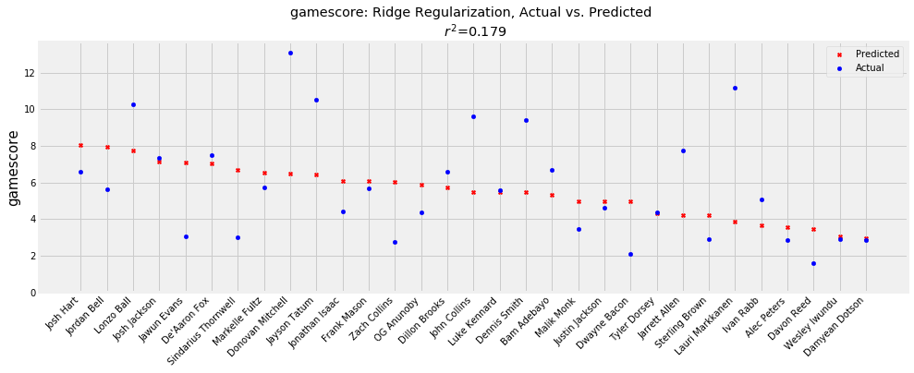
Testing Output: 2017 Draft

Slide 7
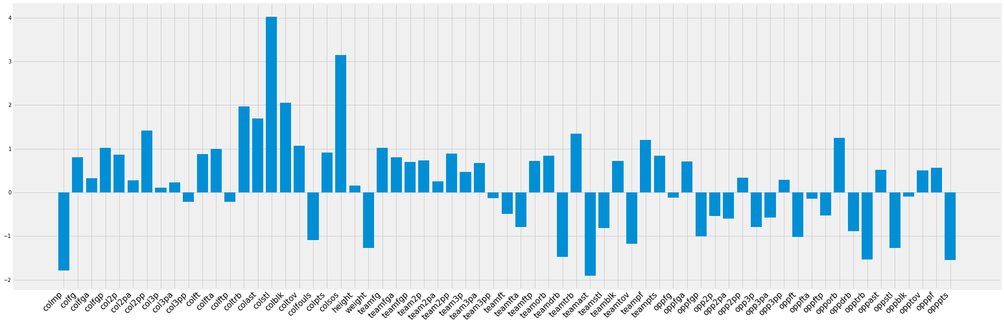
Gamescore Coefficients

Slide 8
Making Predictions
Rank | Player | School | Gamescore
1 | Marvin Bagley III | Duke | 8.416843
2 | Trae Young | Oklahoma | 7.904497
3 | Jevon Carter | West Virgina | 7.360815
4 | Mikal Bridges | Villanova | 7.163707
5 | Bonzie Colson | Notre Dame | 6.943171
6 | Wendell Carter Jr. | Duke | 6.714601
7 | Jalen Brunson | Villanova | 6.701194
8 | DeAndre Ayton | Arizona | 6.572681
9 | Shamorie Ponds | St. John’s | 6.382913
10 | Ethan Happ | Wisconsin | 6.335034
11 | Udoka Azubuike | Kansas | 6.304821
12 | Keita Bates-Diop | Ohio State | 6.295525
13 | Devonte' Graham | Kansas | 6.23705
14 | Grayson Allen | Duke | 6.123156
15 | Donte DiVincenzo | Villanova | 6.122465
Rank | Player | School | Gamescore
16 | Shai Gilgeous-Alexander | Kentucky | 6.04952
17 | Nick Ward | Michigan State | 6.003578
18 | Gary Clark | Cincinnati | 5.915005
19 | Chandler Hutchison | Boise State | 5.912713
20 | Trevon Duval | Duke | 5.90291
21 | Robert Williams | Texas A&M | 5.892416
22 | Mike Watkins | Penn State | 5.749771
23 | Quinndary Weatherspoon | Mississippi State | 5.72941
24 | Eric Paschall | Villanova | 5.707243
25 | Jemerrio Jones | New Mexico St. | 5.698666
26 | Mohamed Bamba | Texas | 5.679473
27 | Luke Maye | UNC | 5.641648
28 | Jock Landale | St. Mary’s | 5.60898
29 | Johnathan Williams | Gonzaga | 5.574771
30 | Miles Bridges | Michigan State | 5.543432

Slide 9
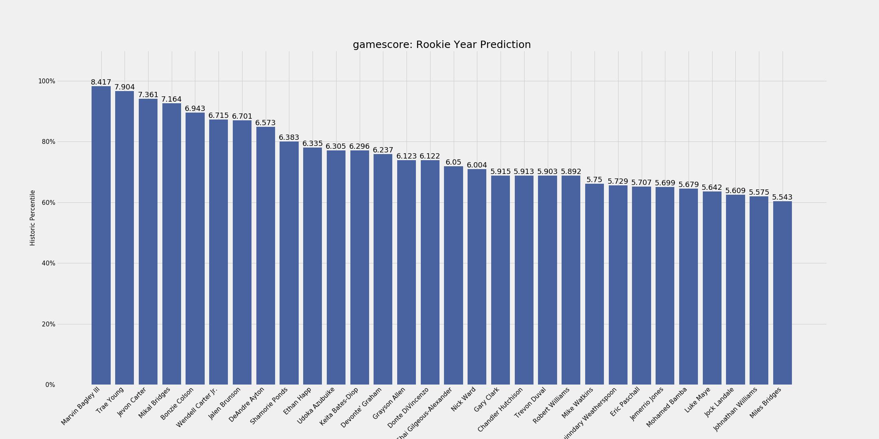
2018 Draft Projections

Slide 10
Conclusion
What makes a good NBA player?
  Physical Traits
  Mental Makeup
  Skill
DATA
Player | Height | Points | Assists | Rebounds | 2P% | 3P% | FT% | SOS | Accolades
NCAA
Jimmer Fredette | 6’ 2” | 28.9 | 4.3 | 3.4 | .491 | .396 | .894 | 5.76 | National POY
Steph Curry | 6’ 3” | 28.6 | 5.6 | 4.4 | .519 | .387 | .876 | -3.33 | Conference POY
NBA Predictions
Player | Height | Points | Assists | Rebounds | 2P% | 3P% | FT% | Gamescore | Accolades (Actual)
Jimmer Fredette | 6’ 2” | 11.3 | 2.9 | 1.8 | .424 | .343 | .858 | 6.69 | 1 x CBA MVP
Steph Curry | 6’ 3” | 12.3 | 3.5 | 2.4 | .430 | .376 | .856 | 8.62 | 2 x NBA MVP; 2 x NBA Champ

Slide 11
Appendix
Detailed Results: http://127.0.0.1:5000/

Slide 12
Detailed Results
Statistic | Feature Selection Method | Test R² | Draft Class Median | Draft Class Max
FG% | Lasso Regularization | 0.366207 | 0.429827 | 0.510128
3P% | K-Best Features | 0.332641 | 0.261217 | 0.375978
2P% | K-Best Features | 0.194724 | 0.454221 | 0.518594
EFG% | K-Best Features | 0.311713 | 0.464231 | 0.50083
FT% | Ridge Regularization | 0.121601 | 0.721218 | 0.829804
Rebounds | Ridge Regularization | 0.442531 | 3.093954 | 6.127933
Assists | Ridge Regularization | 0.474369 | 1.466661 | 4.017836
Steals | Lasso Regularization | 0.342148 | 0.613367 | 1.130955
Blocks | Ridge Regularization | 0.632730 | 0.33207 | 1.109172
Turnovers | Ridge Regularization | 0.246314 | 1.165161 | 1.960257
Points | Lasso Regularization | 0.185473 | 7.138516 | 11.837914
Gamescore | Ridge Regularization | 0.174213 | 5.121090 | 8.931220

Slide 13
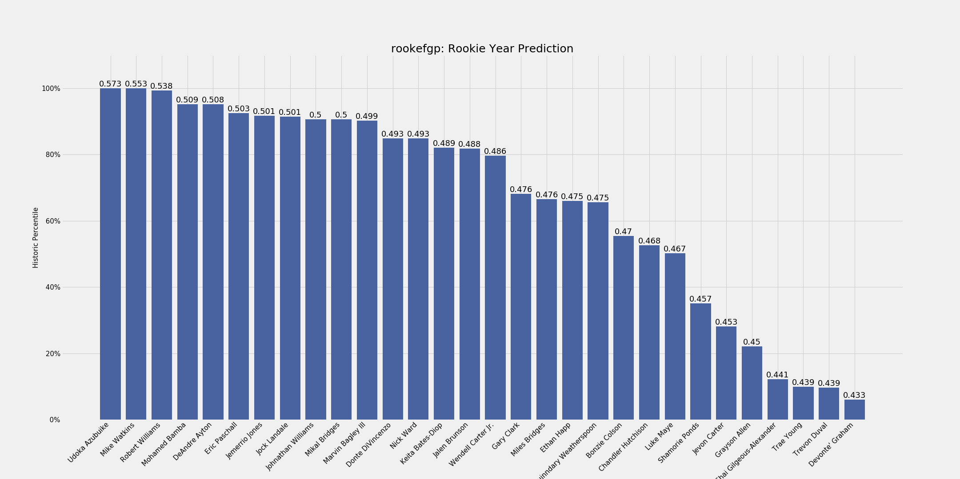
2018 Draft Projections

Slide 14
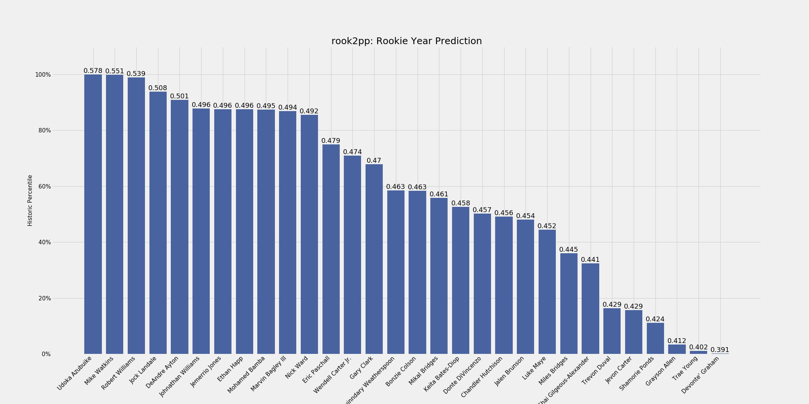
2018 Draft Projections

Slide 15
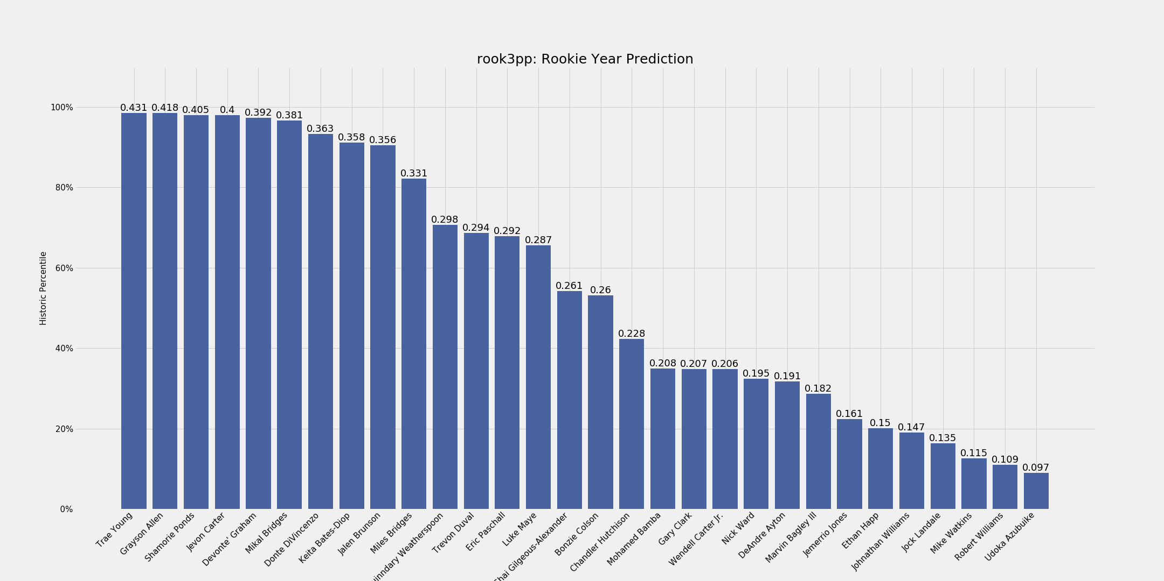
2018 Draft Projections

Slide 16
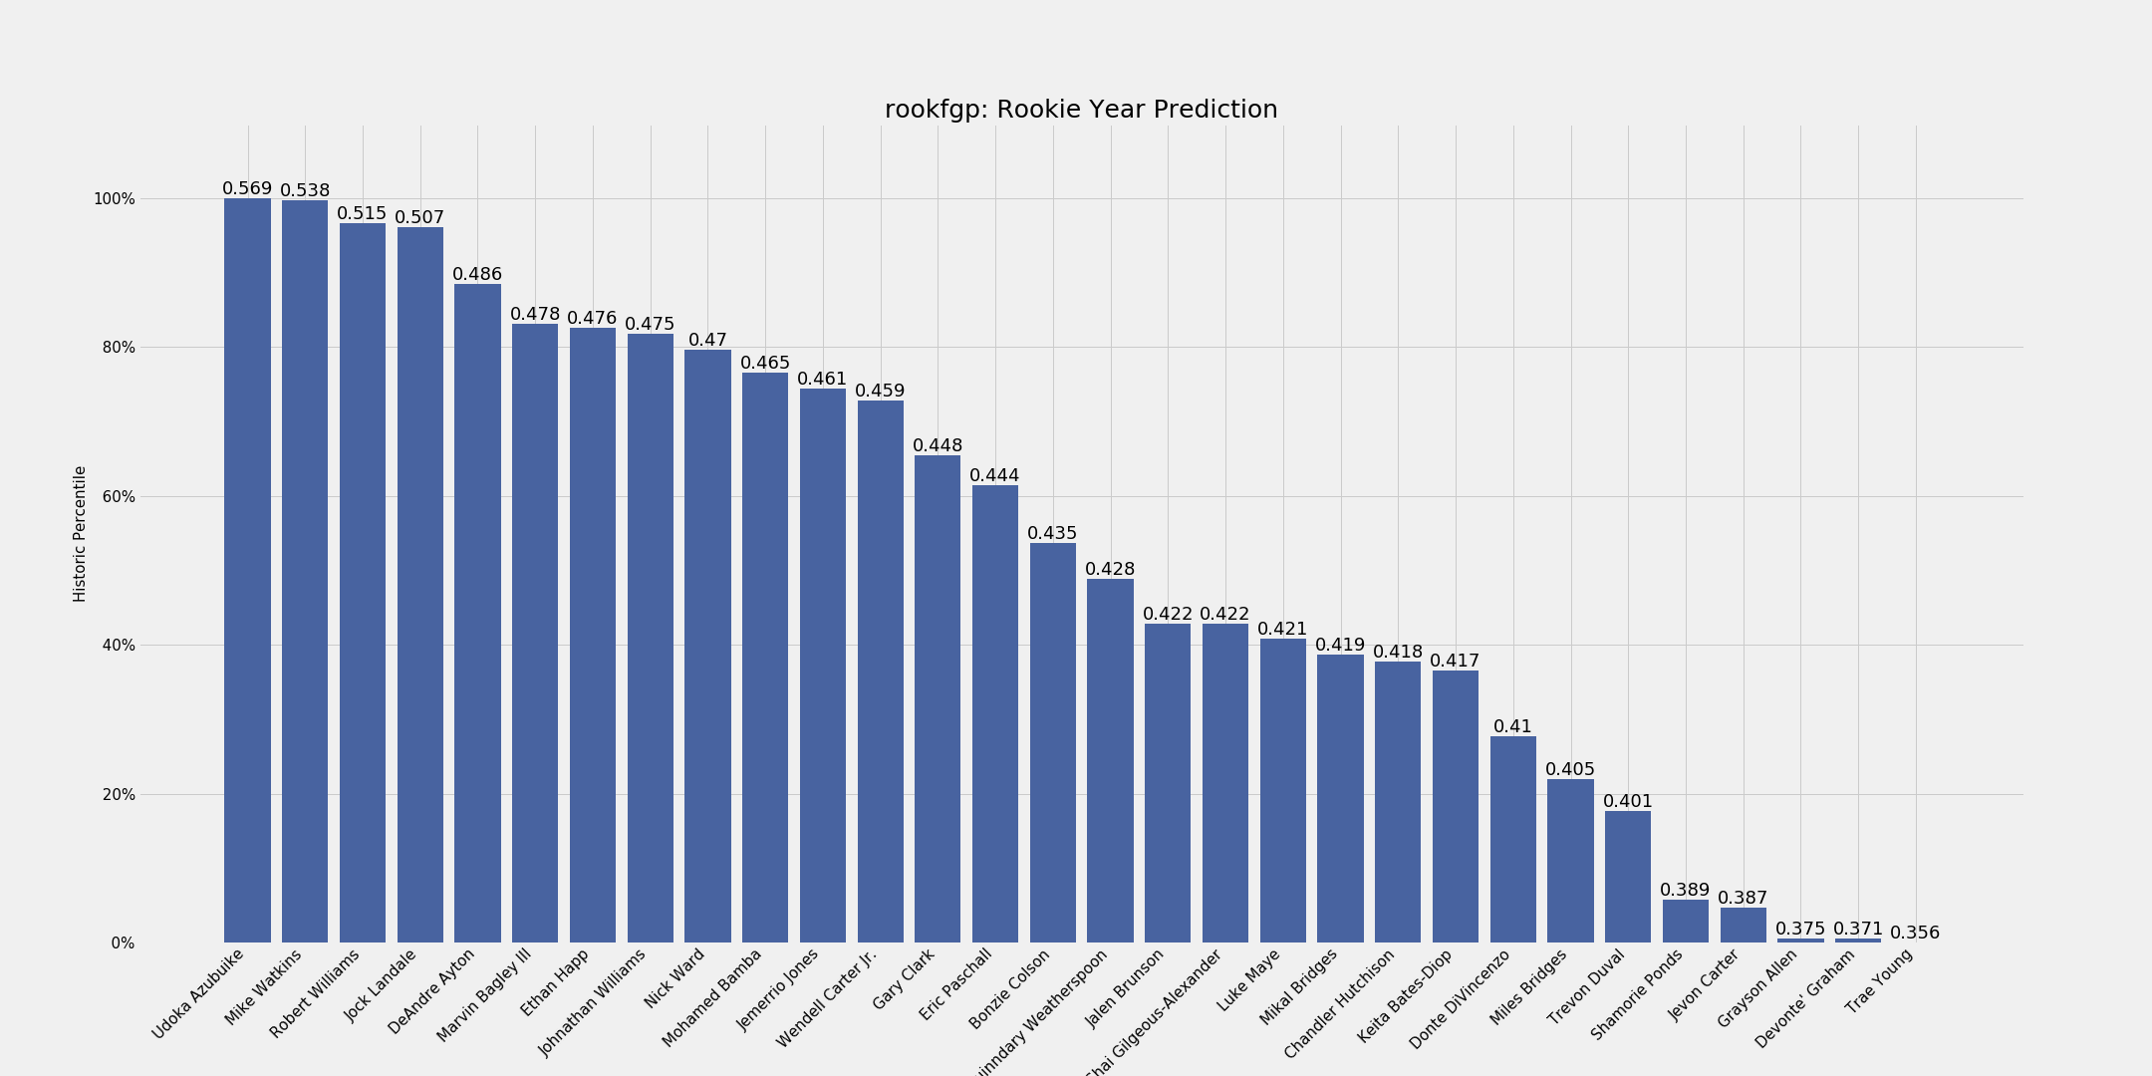
2018 Draft Projections

Slide 17
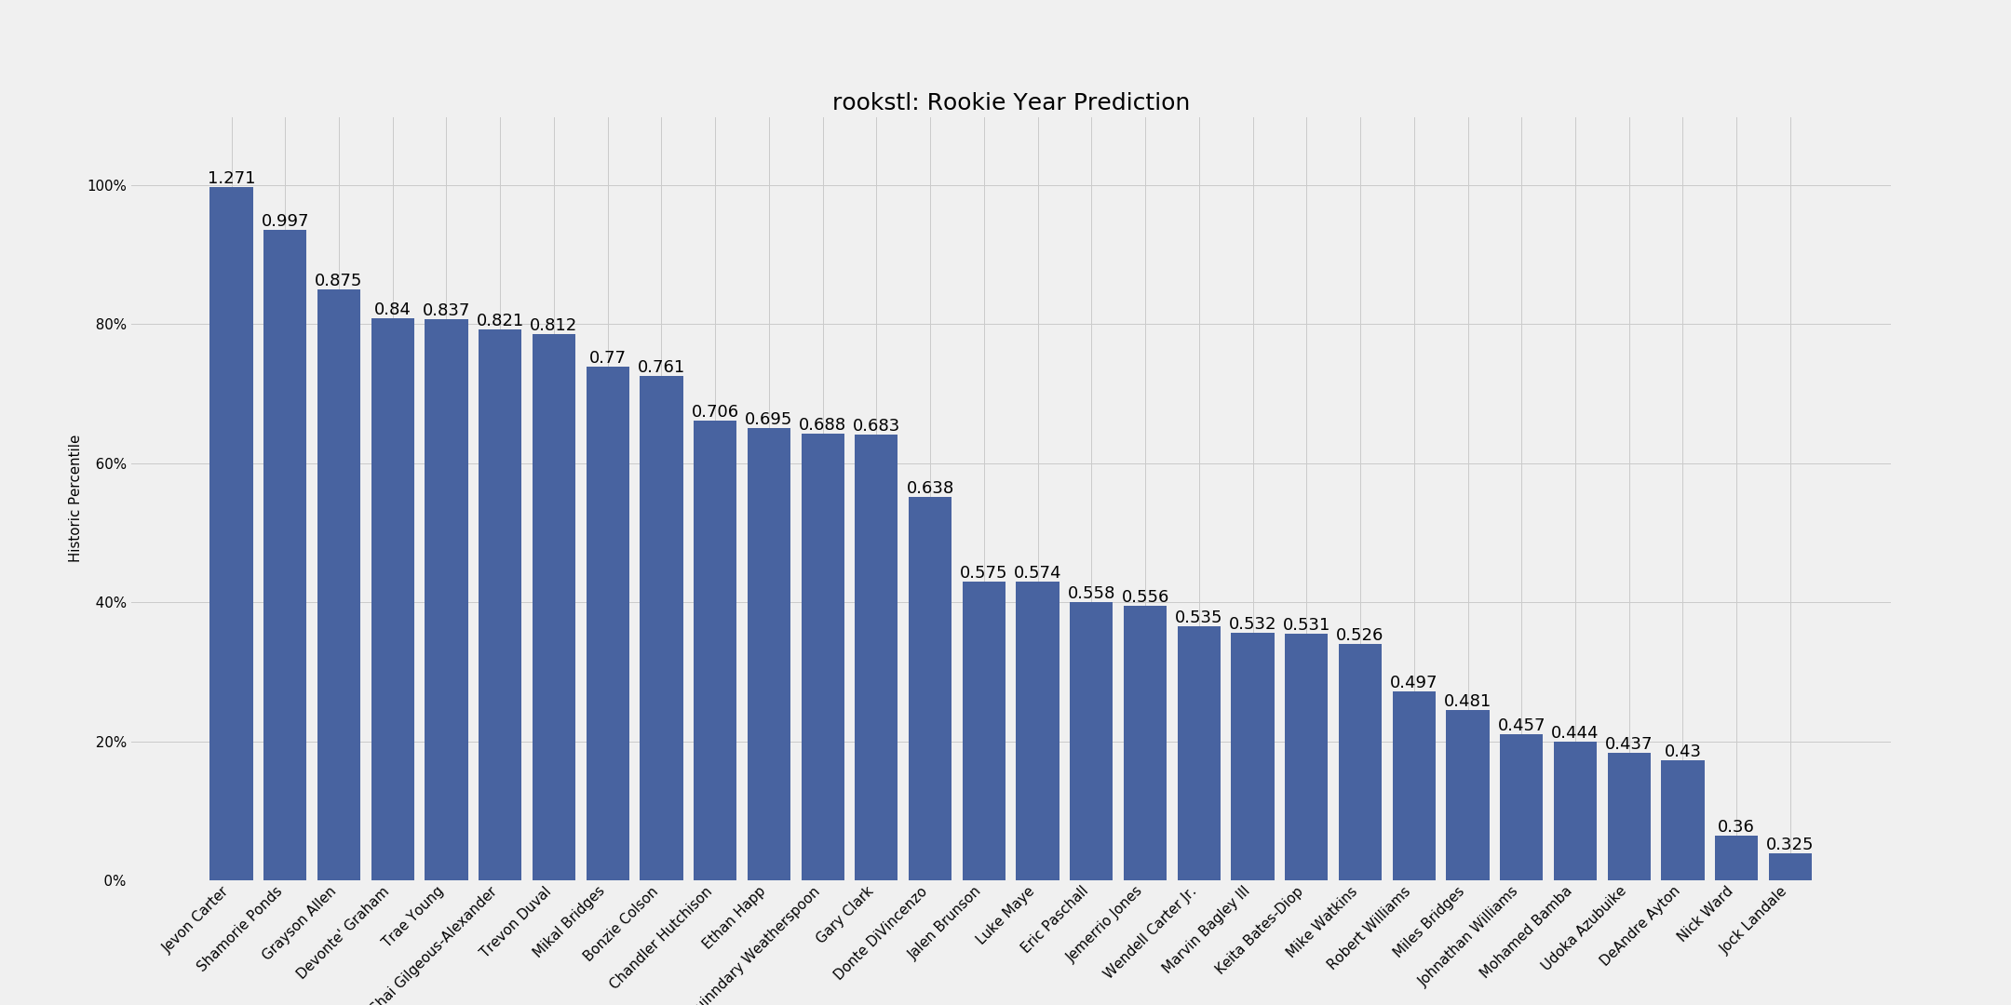
2018 Draft Projections

Slide 18
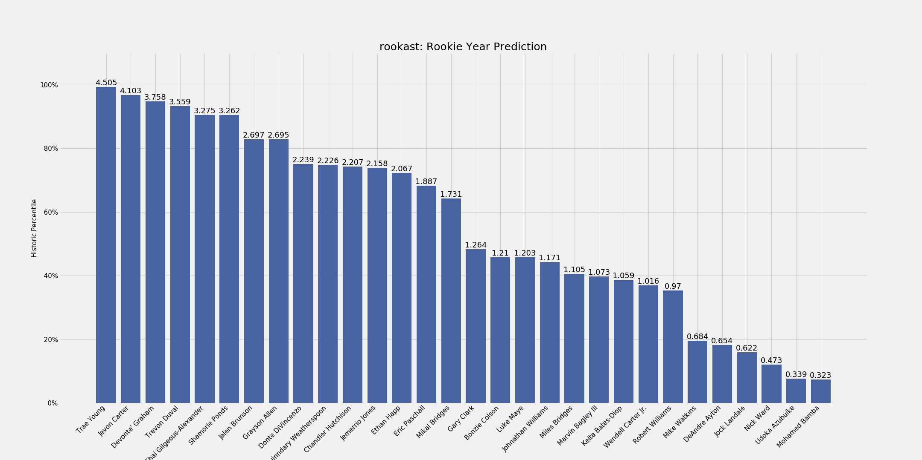
2018 Draft Projections

Slide 19
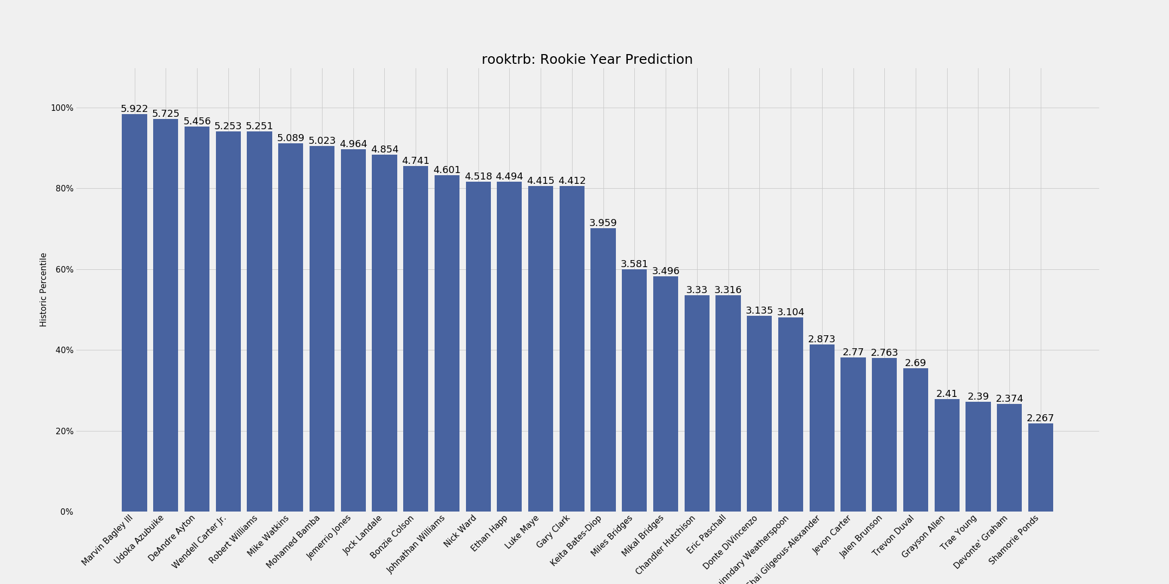
2018 Draft Projections

Slide 20
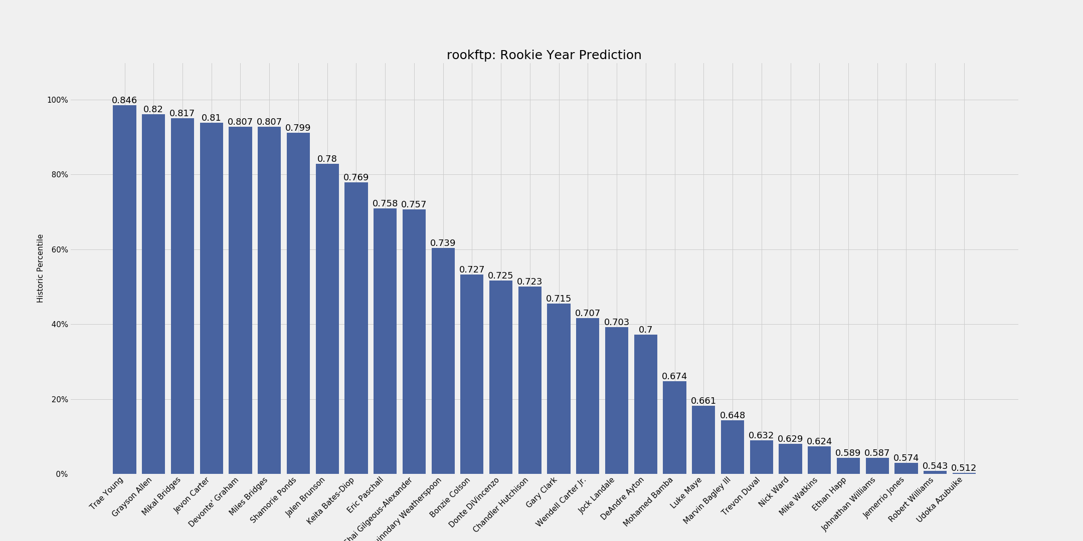
2018 Draft Projections

Slide 21
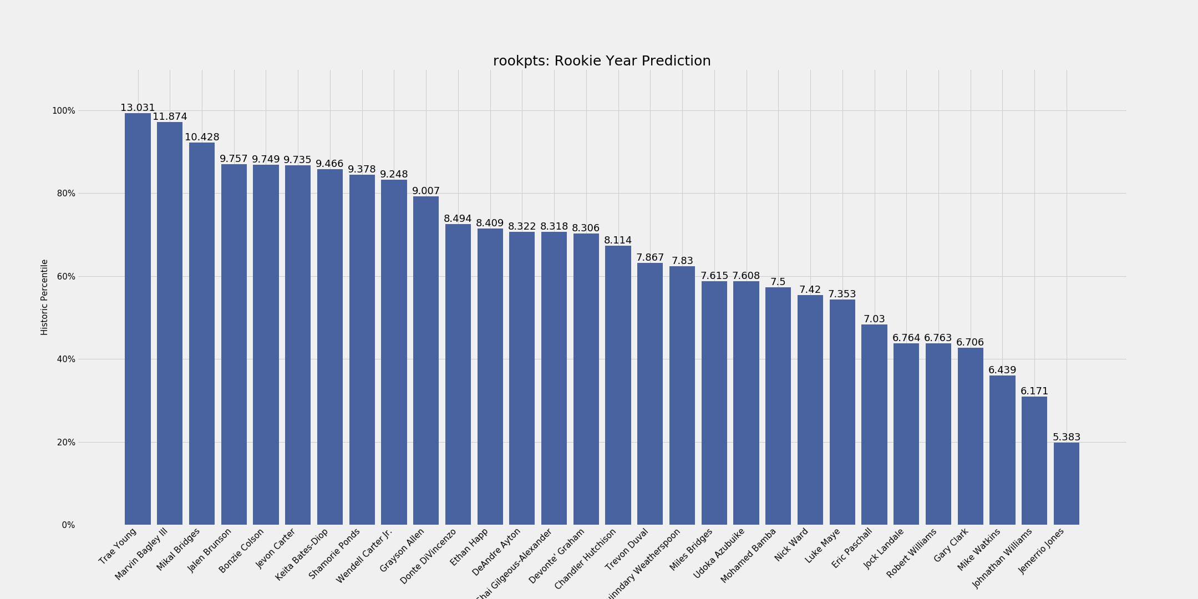
2018 Draft Projections

Slide 22
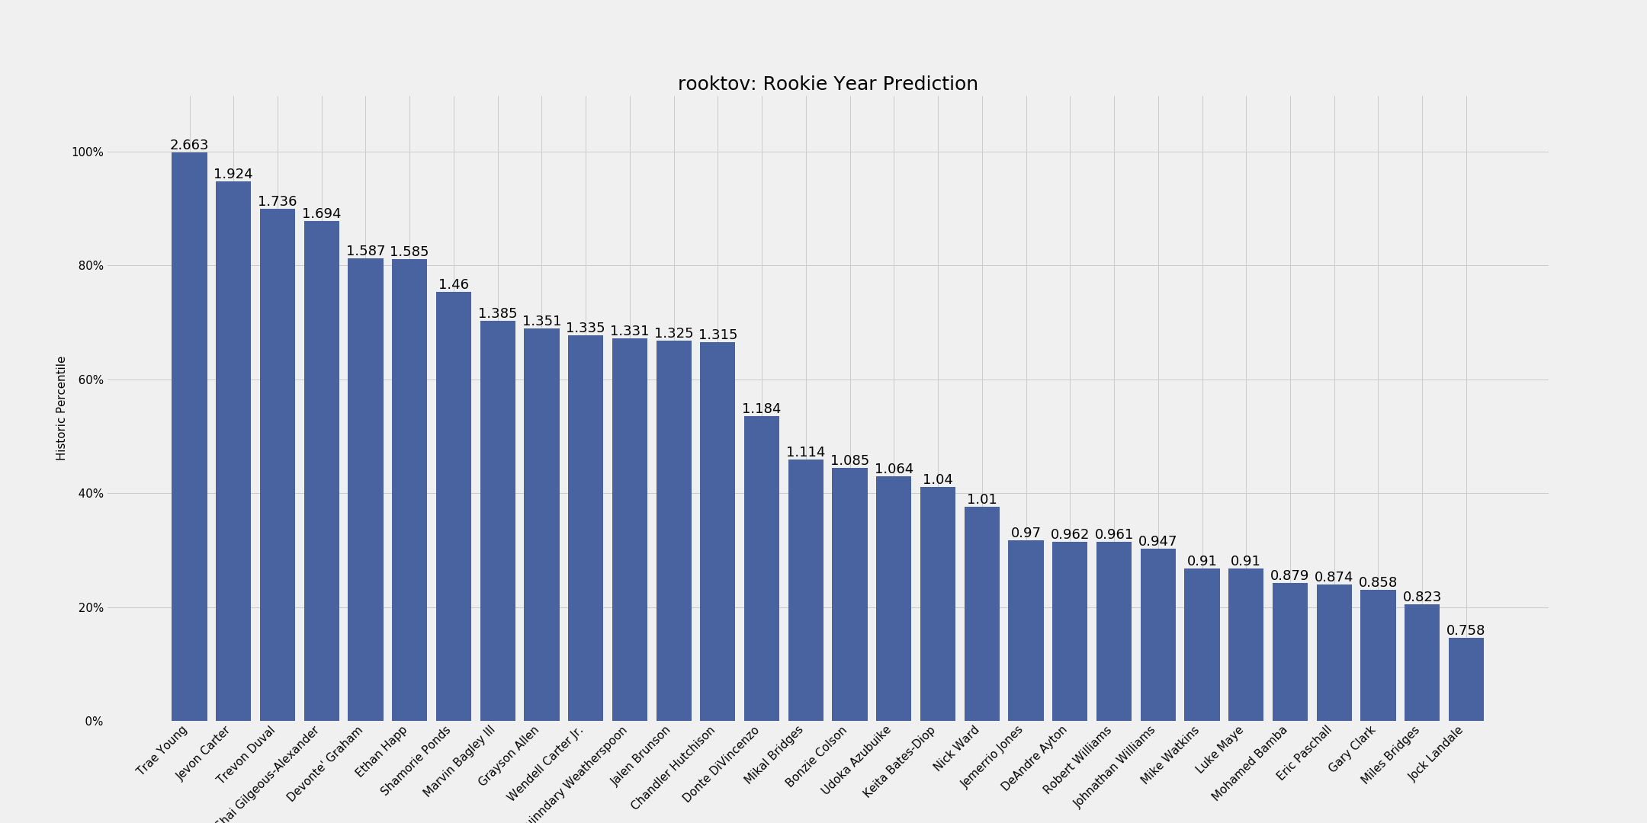
2018 Draft Projections

Slide 23
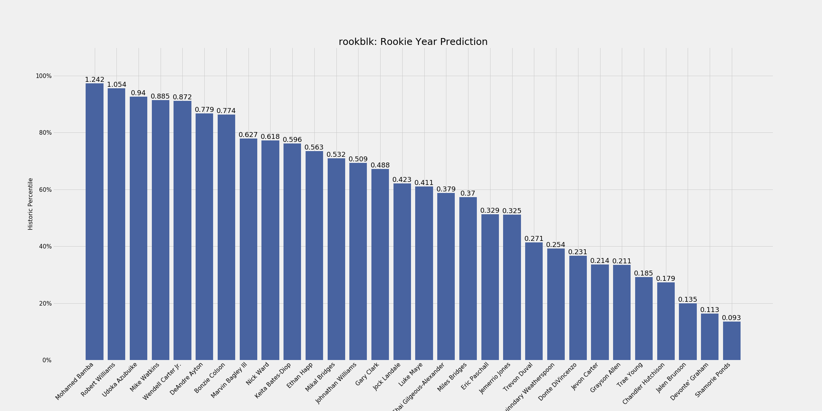
2018 Draft Projections

